Slide 1
Forage - Tata Data Visualization: Empowering Business with Effective Insights
Presented by,
Mohammed Zaheer Aswath

Slide 2
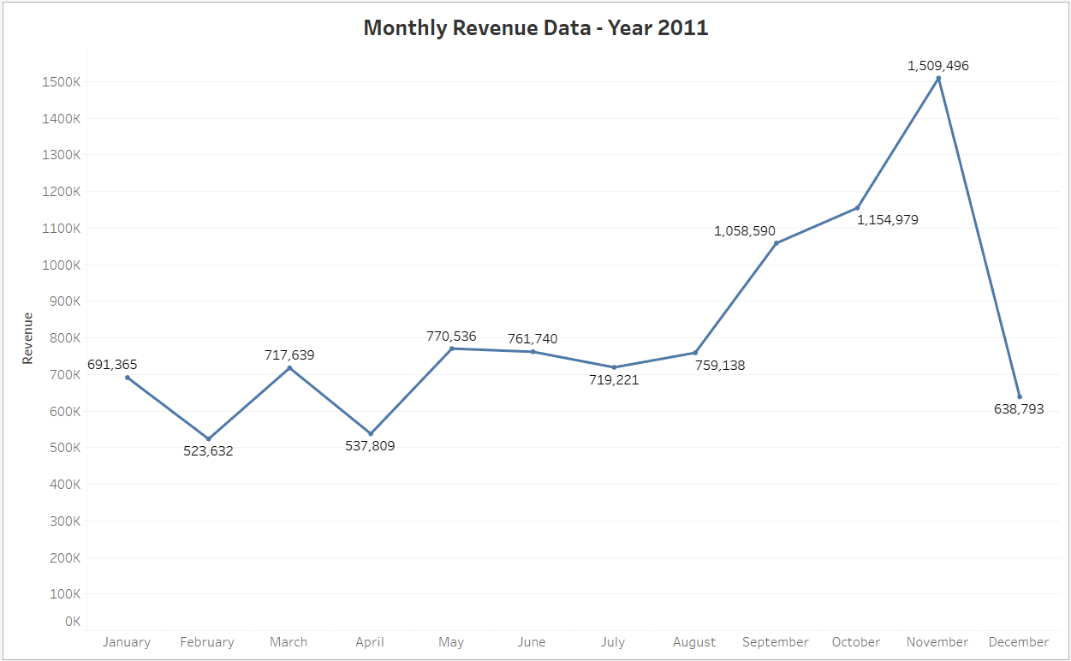

Slide 3
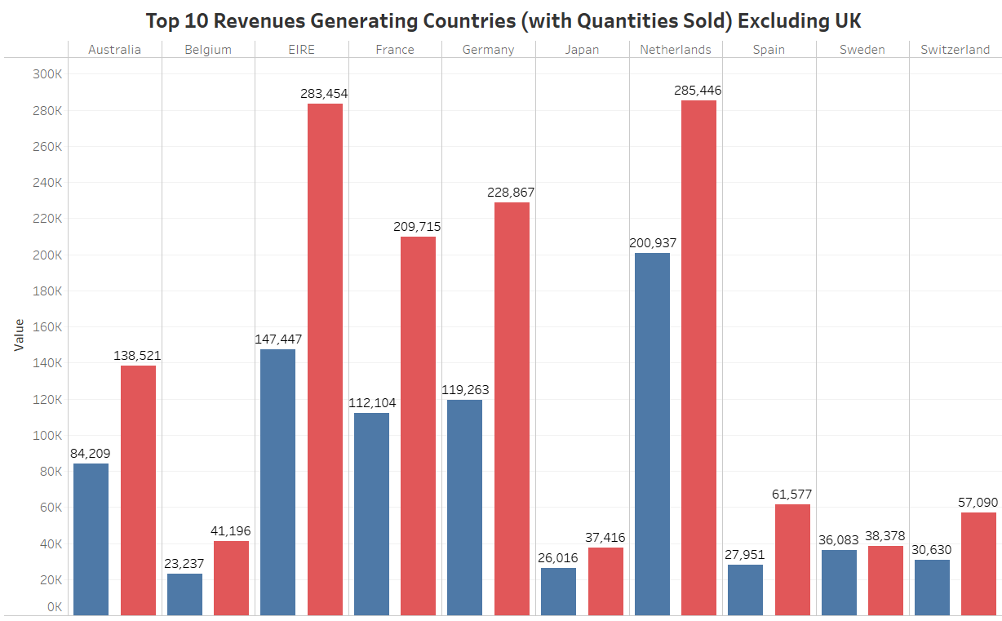

Slide 4
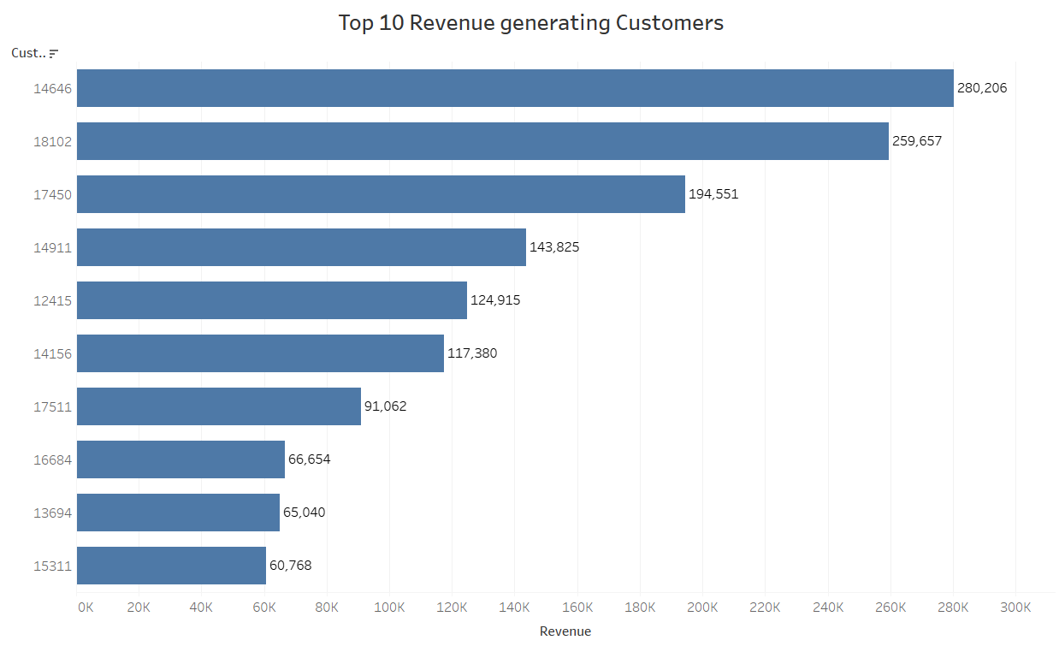

Slide 5
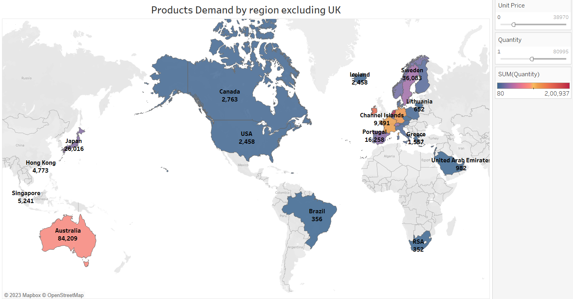

Slide 6
THANK YOU

